Slide 1
Review of Photoimageable Thick Film Process and Applications
By Steve Muckett – Mozaik
Ver. 1A

Slide 2












Our Customers
Mozaik Technology Ventures Limited Suites 34-35, The Hop Exchange, 24 Southwark St., SE1 1TY London UK | tel. +44 (0) 20 7357 7376 | fax +44 (0) 20 7357 9449 |

Slide 3
I. Fine Line Process Background
Mozaik Technology Ventures Ltd., Suites 34-35, The Hop Exchange, 24 Southwark St., SE1 1TY London UK | tel. +44 (0) 20 7357 7376 | fax +44 (0) 20 7357 9449 |

Slide 4
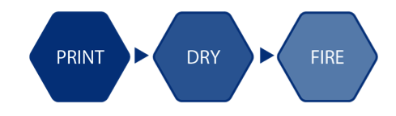
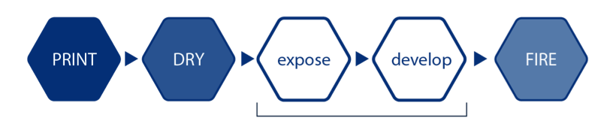
Fine Line process as a good add-on: just two more simple steps
Standard Thick Film Process
Good for lines / gaps
down to 75 um
Photoimageable Thick Film Process
Just two more process steps
Instant result, no hazardous chemicals
UV Exposure and imaging with water spray
Mozaik Technology Ventures Ltd., Suites 34-35, The Hop Exchange, 24 Southwark St., SE1 1TY London UK | tel. +44 (0) 20 7357 7376 | fax +44 (0) 20 7357 9449 |

Slide 5
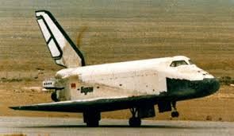
Photoimageable Paste Know How
1975 First patents by Du Pont (Fodel) 1975
during 1980’s and 1990’s Fodel pastes evaluated
Soviet project ‘TORNADO’ starts in 1980. Patents in 1983. (Hibridas pastes). Formerly Thick Film Dept of Radio Measurement Engineering Research Institute. Privatised in 1990’s
Photoimageable pastes used for microwave applications in Soviet Union since 1985
Mozaik collaborates with Hibridas since 1997. Machines & pastes and prototype services business developed.
Mozaik Technology Ventures Limited Suites 34-35, The Hop Exchange, 24 Southwark St., SE1 1TY London UK | tel. +44 (0) 20 7357 7376 | fax +44 (0) 20 7357 9449 |

Slide 6
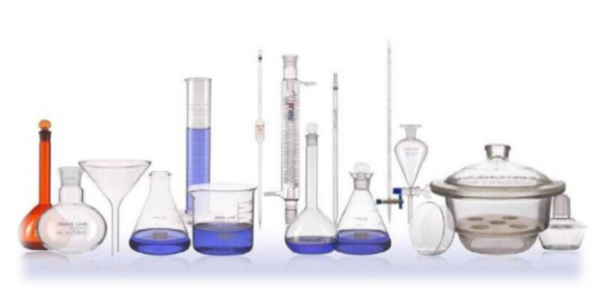
Hibridas Know How
Photosensitive crosslinkable liquid polymer synthesised in 4 stages without isolation of intermediates. Robust, stable & not sensitive to low level white light.
Manufacture of organic vehicle and resulting photoimageable thick film pastes with good stability and compatibility with various metal powders and substrates & green tapes. Non tacky film after drying. Clean burn-out without residues.
Mozaik Technology Ventures Limited Suites 34-35, The Hop Exchange, 24 Southwark St., SE1 1TY London UK | tel. +44 (0) 20 7357 7376 | fax +44 (0) 20 7357 9449 |

Slide 7
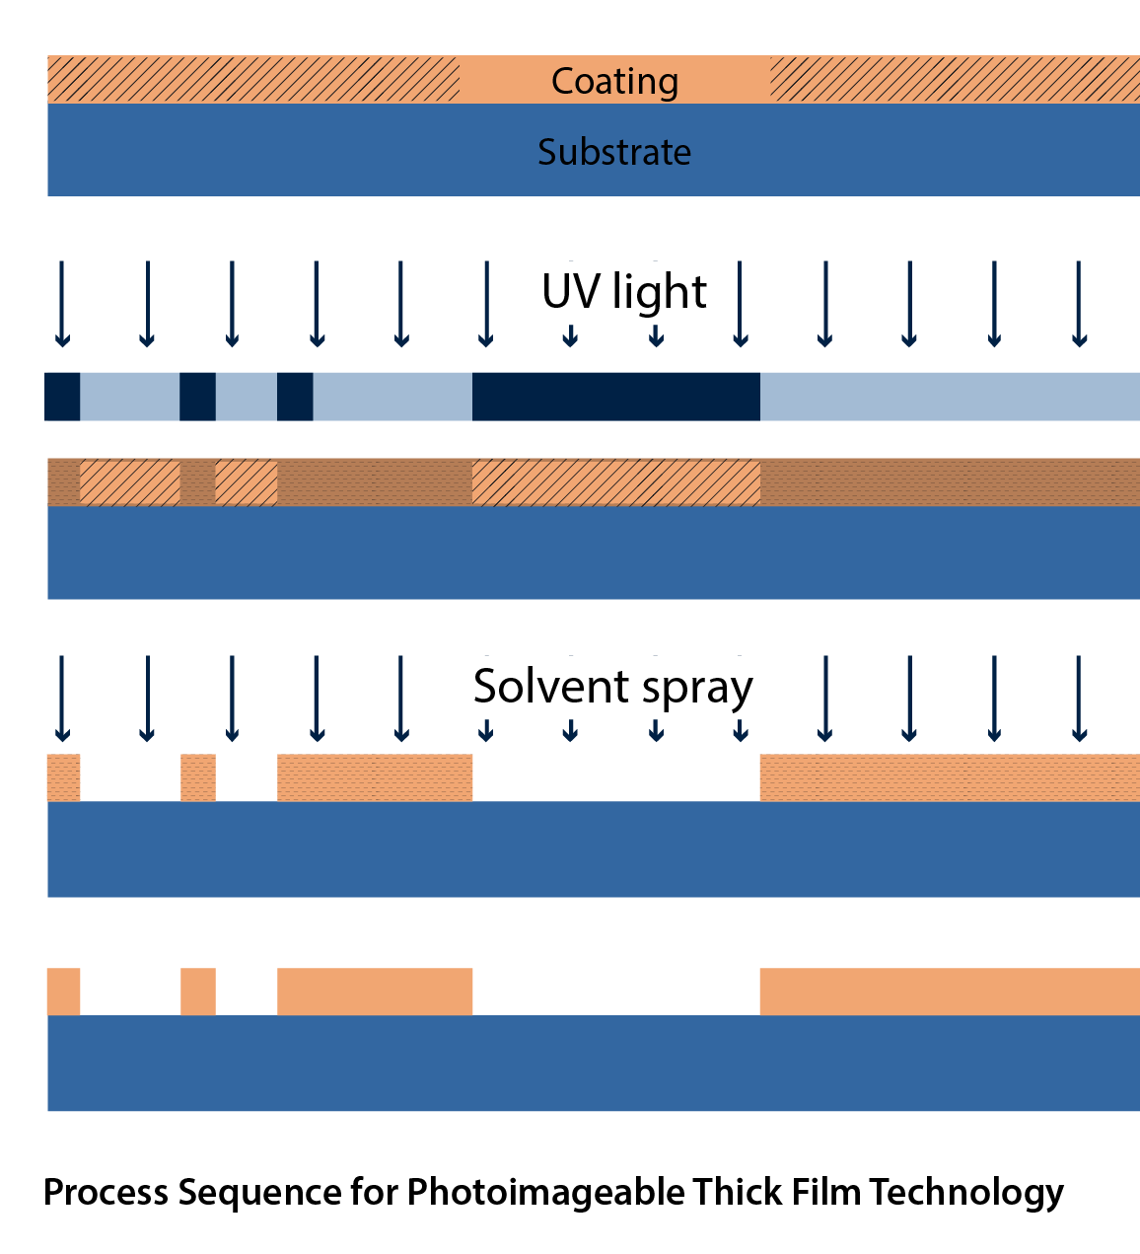
How It Works?
1
Screen Printing and Drying
Photomask (glass or PE)
Exposure
Imaging
Firing in air
2
Atomised Water Spray
3
4
Mozaik Technology Ventures Limited Suites 34-35, The Hop Exchange, 24 Southwark St., SE1 1TY London UK | tel. +44 (0) 20 7357 7376 | fax +44 (0) 20 7357 9449 |

Slide 8
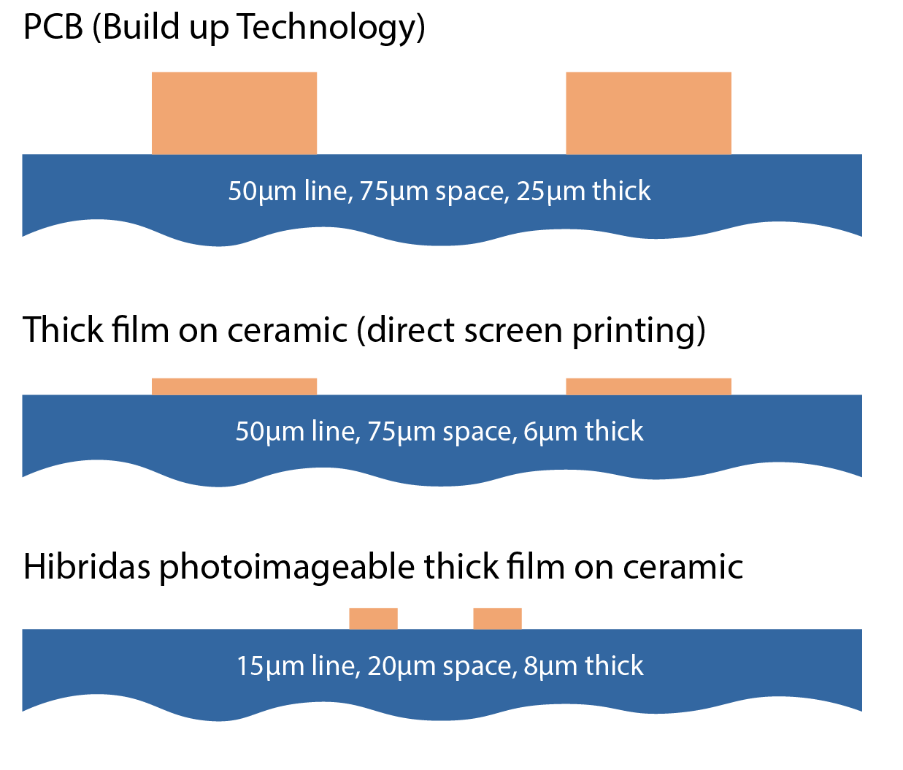
Line & Space resolutions possible
Mozaik Technology Ventures Limited Suites 34-35, The Hop Exchange, 24 Southwark St., SE1 1TY London UK | tel. +44 (0) 20 7357 7376 | fax +44 (0) 20 7357 9449 |

Slide 9
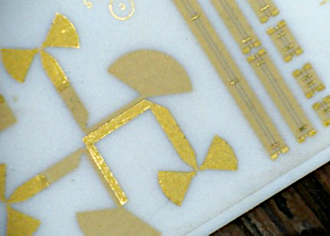
Applications of Photoimageable Thick Film
High Density Interconnect
15 micron line / 20 micron space with high yield on standard ceramic.
30 micron line / 40 micron space with 50 micron vias for multilayers.
20 micron lines / 30 micron space within LTCC & HTCC structures.
RF & Microwave (up to 200GHz is reported)
Sensor Elements (narrow conductors and windows in dielectric and MEMS with ceramic/dielectrics).
10 micron lines / 15 micron spaces at up to 10 microns fired thickness is possible!
Components like Fuses & MLCI Chip inductors
Plasma Displays and RF shielding on glass
Application example: Multilayer RF Circuit
Mozaik Technology Ventures Limited Suites 34-35, The Hop Exchange, 24 Southwark St., SE1 1TY London UK | tel. +44 (0) 20 7357 7376 | fax +44 (0) 20 7357 9449 |

Slide 10
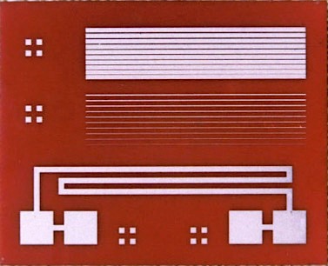
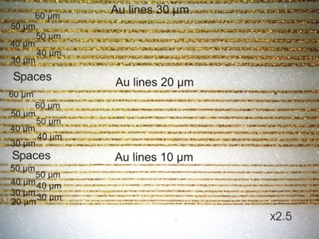
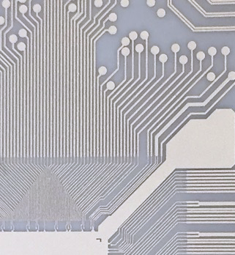
History Milestones
1993
HC4700 silver paste on 94% alumina
Finest Line 15 um, smallest gap 20 um
Kaunas, Lithuania
2013
New Generation of gold paste
2018
Adaptations for innovative substrates types
Mozaik Technology Ventures Limited Suites 34-35, The Hop Exchange, 24 Southwark St., SE1 1TY London UK | tel. +44 (0) 20 7357 7376 | fax +44 (0) 20 7357 9449 |

Slide 11
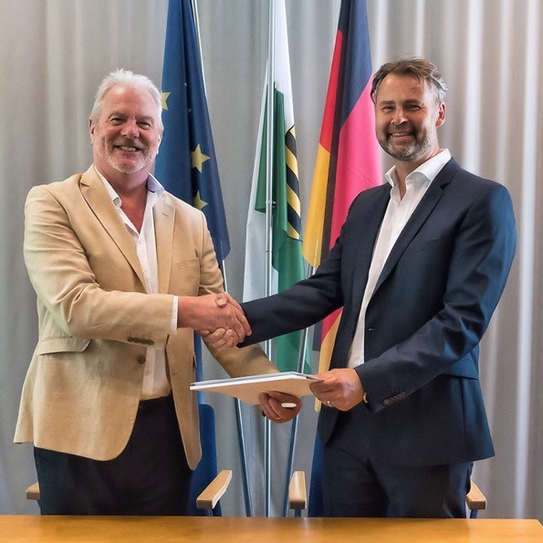
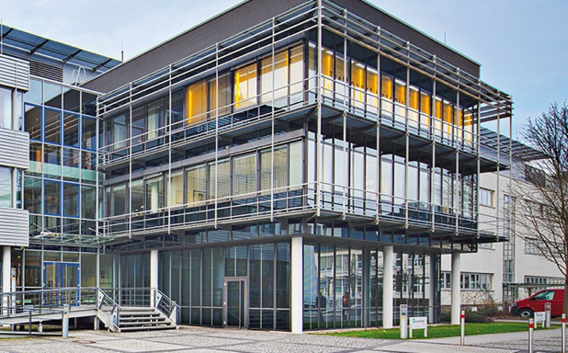

History Milestones
Steve Muckett
External PI-paste Consultant
Fraunhofer Institute for Ceramic Technologies
and systems IKTS
Winterbergstr. 28 | 01277 Dresden | Germany
Phone + 44 7802 301 806
pi-pastes@ikts.Fraunhofer.de | www.ikts.fraunhofer.de
2019
A Global License Agreement for Photoimageable Pastes Production.
Signed by Fraunhofer IKTS, Dresden and Mozaik Technology Ventures Ltd.
Mozaik Technology Ventures Limited Suites 34-35, The Hop Exchange, 24 Southwark St., SE1 1TY London UK | tel. +44 (0) 20 7357 7376 | fax +44 (0) 20 7357 9449 |

Slide 12
II. Fine Line Process Parameters
Mozaik Technology Ventures Ltd., Suites 34-35, The Hop Exchange, 24 Southwark St., SE1 1TY London UK | tel. +44 (0) 20 7357 7376 | fax +44 (0) 20 7357 9449 |

Slide 13
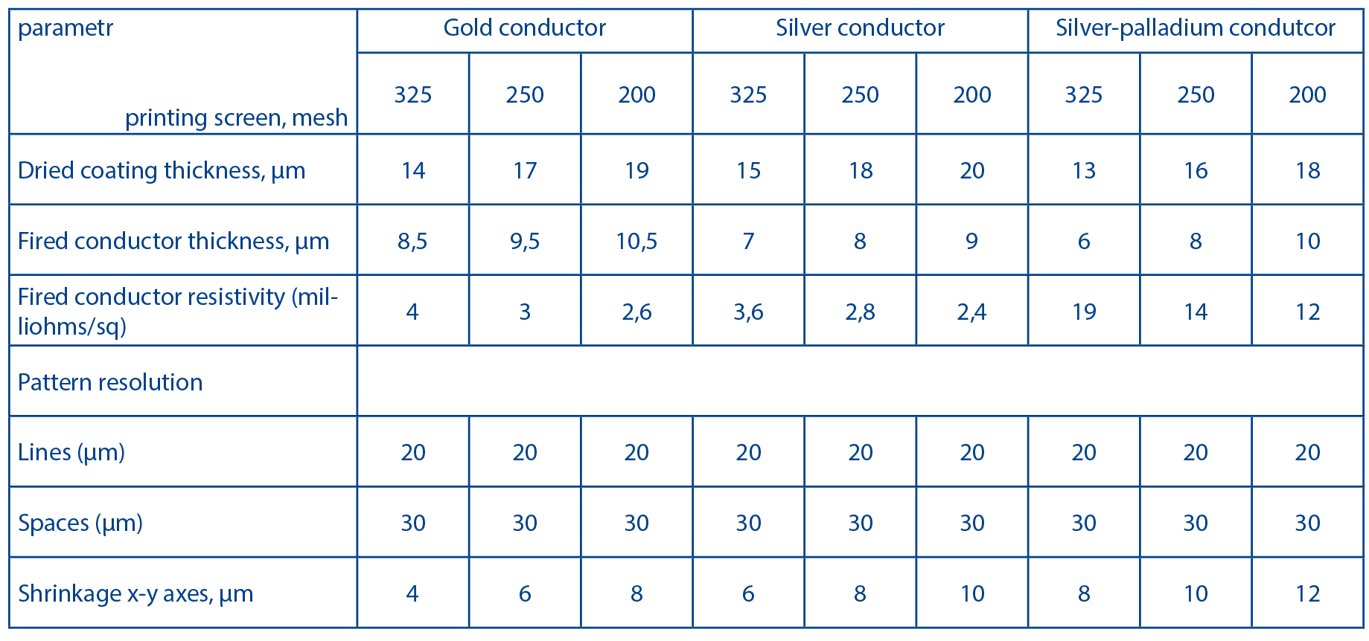
Typical data for photoimageable conductor pastes on ‘as fired’ 96% alumina
Mozaik Technology Ventures Limited Suites 34-35, The Hop Exchange, 24 Southwark St., SE1 1TY London UK | tel. +44 (0) 20 7357 7376 | fax +44 (0) 20 7357 9449 |

Slide 14
Standard and custom pastes available
Ag series (96% & 99.6% Al₂O₃, AlN, LTCC, PDP glass)
Au series (96% and 99.6% Al₂O₃, sapphire, AlN)
Ag-Pd, Ag-Pt (alloys and mixes)
Pt (variants for Al₂O₃ and Zirconia)
W (for HTCC)
Dielectric (multilayer blue & clear variants)
Resistors (customer specific only)
Custom glass, dielectric, conductor pastes can be considered
Mozaik Technology Ventures Limited Suites 34-35, The Hop Exchange, 24 Southwark St., SE1 1TY London UK | tel. +44 (0) 20 7357 7376 | fax +44 (0) 20 7357 9449 |

Slide 15
“Mozaik” and DuPont processing comparison chart
Processing Characteristics | IKTS silver | DuPont FODEL 6778 silver
Cleanroom type for print & fire | Normal white light conditions | “Yellow Room” lighting
Printing screen type | 325 mesh preferred | 200 mesh preferred
Drying temperature | 120 ºC preferred | 80 ºC preferred
Exposure time * | Less than 10 s | 40 s
Exposure type ** | Higher intensity, short time (80 mJ/cm² s) | Lower intensity, long time (40 mJ/cm² s)
Developing | DI water with < 0,1% MEA or sodium carbonate (no waste treatment needed)
Firing | 850 ºC peak, 60 min standard profile
* Best image quality is achieved when energy is applied in the shortest time
** DuPont Fodel paste is sensitive to lower level UV but needs longer time of exposure.
“Mozaik” paste needs X2 the intensity of UV but in a shorter time,
which explains a better resolution achieved.
Data taken from published datasheets
Mozaik Technology Ventures Limited Suites 34-35, The Hop Exchange, 24 Southwark St., SE1 1TY London UK | tel. +44 (0) 20 7357 7376 | fax +44 (0) 20 7357 9449 |

Slide 16
“Mozaik” pastes properties after firing
Properties | Photoimageable IKTS Silver
Best Line / space resolution on “as fired” alumina, um | 20 / 30
on lapped / polished alumina, um | 10 / 20
Shrinkage after firing in X / Y | < 10%
Solids content | 80%
Fired thickness, um (with preferred mesh screen) | 5 - 8
Resistivity, milliΩ/sq (at above thickness) | 3 – 4
Mozaik Technology Ventures Limited Suites 34-35, The Hop Exchange, 24 Southwark St., SE1 1TY London UK | tel. +44 (0) 20 7357 7376 | fax +44 (0) 20 7357 9449 |

Slide 17
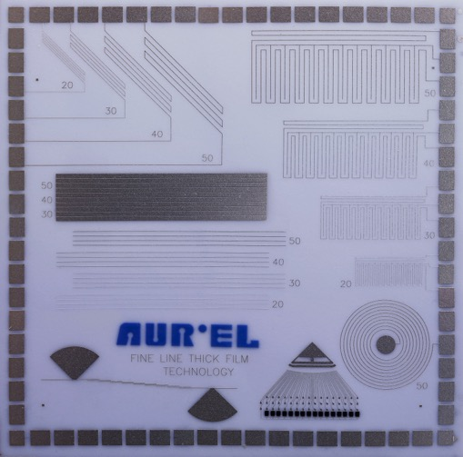
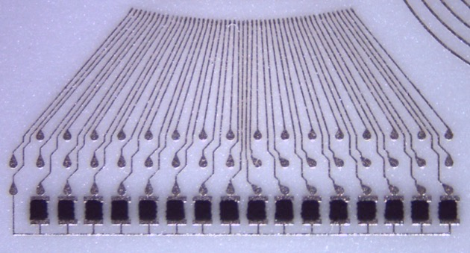
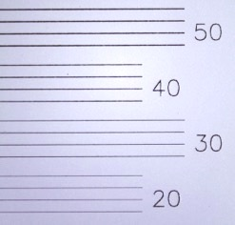
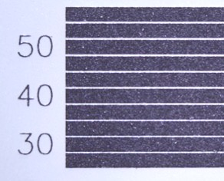
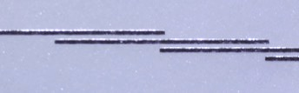
State of the Art
Test Samples (Italy, 2017)
30um lines fan-out with chip-resistors
Fired 96% alumina
Test Sample 50 x 50 mm
Lines
Spaces
THICKNESS OF LINES > 6 um, EXCELLENT CONDUCTIVITY!
RF features
Mozaik Technology Ventures Limited Suites 34-35, The Hop Exchange, 24 Southwark St., SE1 1TY London UK | tel. +44 (0) 20 7357 7376 | fax +44 (0) 20 7357 9449 |

Slide 18
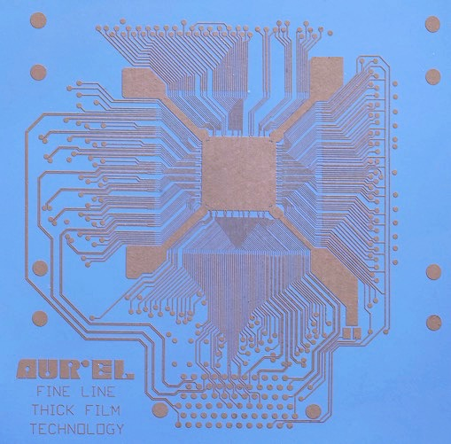
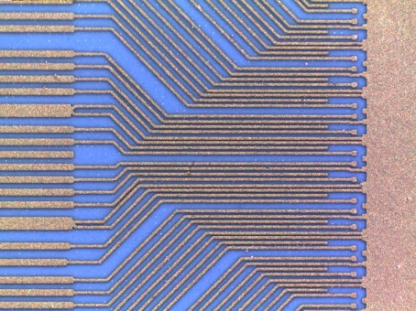
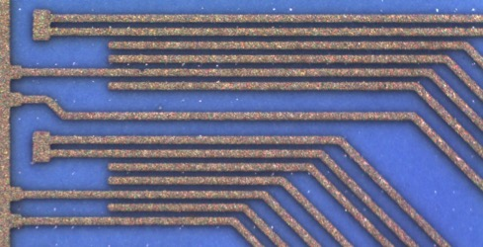
State of the Art
Test Samples (Italy, 2017)
40um lines fan-out
Green LTCC
Test Sample 50 x 50 mm
Gaps 30 um
THICKNESS OF LINES > 6 um, EXCELLENT CONDUCTIVITY!
Mozaik Technology Ventures Limited Suites 34-35, The Hop Exchange, 24 Southwark St., SE1 1TY London UK | tel. +44 (0) 20 7357 7376 | fax +44 (0) 20 7357 9449 |

Slide 19
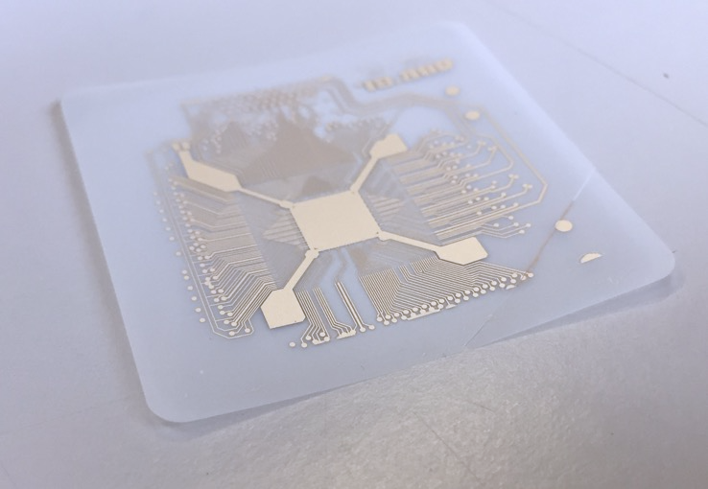
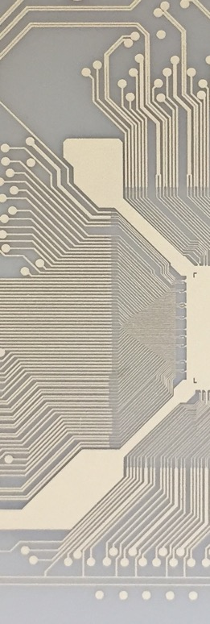
State of the Art
Test Samples (Italy, 2018)
NEW
Fired ceramic, 20um thick, flexible
Test Sample 50 x 50 mm
40um lines fan-out
Gaps 30 um
THICKNESS OF LINES > 6 um, EXCELLENT CONDUCTIVITY!
Mozaik Technology Ventures Limited Suites 34-35, The Hop Exchange, 24 Southwark St., SE1 1TY London UK | tel. +44 (0) 20 7357 7376 | fax +44 (0) 20 7357 9449 |

Slide 20
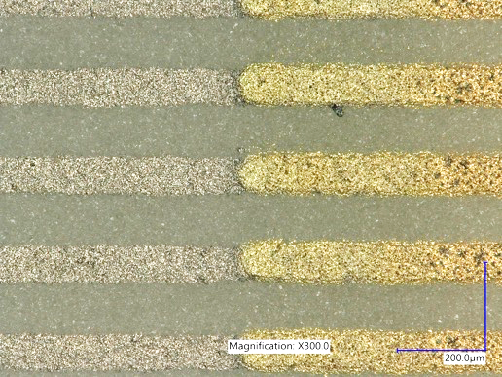
Multilayer Photoimageable Paste Structure
IMAGES PROTECTED BY NDA
Multilayer Ag – Au fan-out
Test Structure incorporating three
layers of photoimageable pastes:
Conductors (Ag-Pd, Au) and blue dielectric
Mozaik Technology Ventures Limited Suites 34-35, The Hop Exchange, 24 Southwark St., SE1 1TY London UK | tel. +44 (0) 20 7357 7376 | fax +44 (0) 20 7357 9449 |

Slide 21
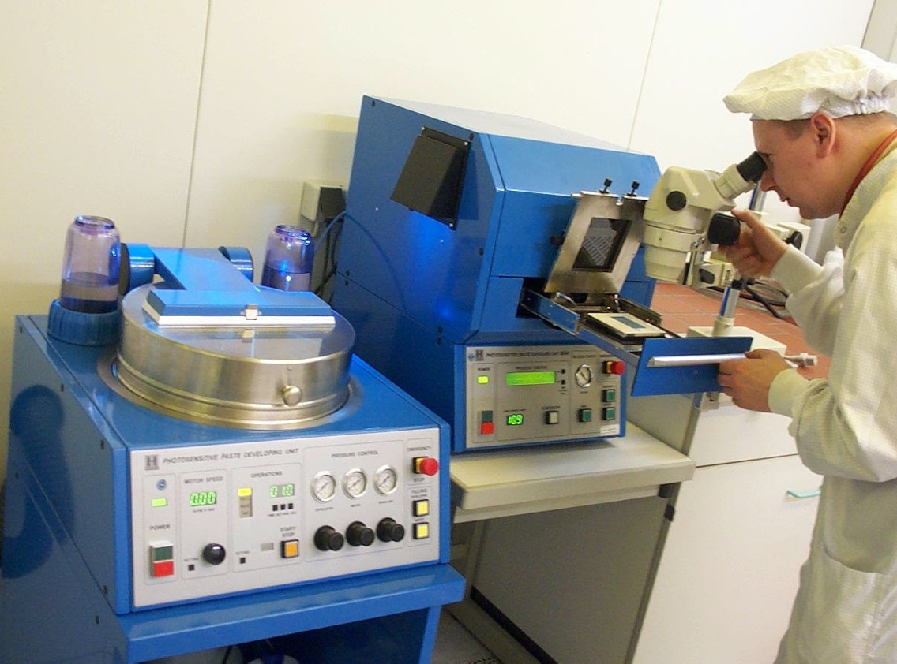
Original Hibridas Machines
Delivered in 2001 – 2005
Mozaik Technology Ventures Limited Suites 34-35, The Hop Exchange, 24 Southwark St., SE1 1TY London UK | tel. +44 (0) 20 7357 7376 | fax +44 (0) 20 7357 9449 |

Slide 22
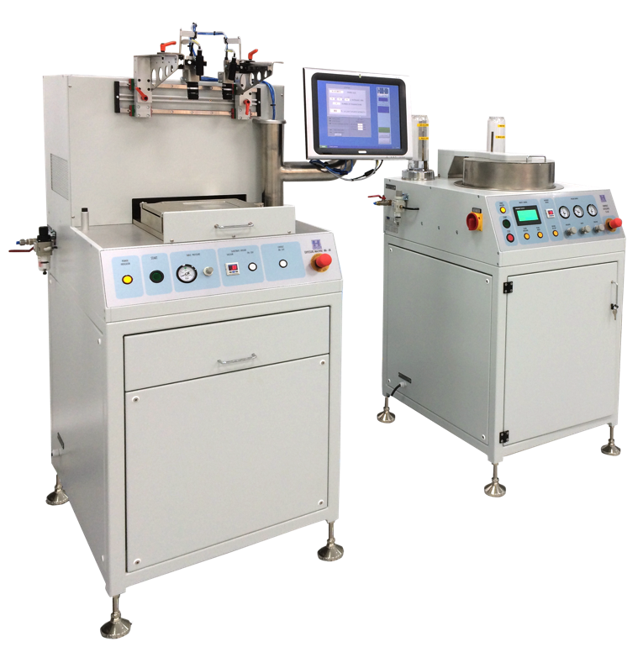
Entry level Machines
Delivered in 2014-17
SC-6K
Water Spray Developer
MA-6K
UV-exposure
Mozaik Technology Ventures Limited Suites 34-35, The Hop Exchange, 24 Southwark St., SE1 1TY London UK | tel. +44 (0) 20 7357 7376 | fax +44 (0) 20 7357 9449 |

Slide 23
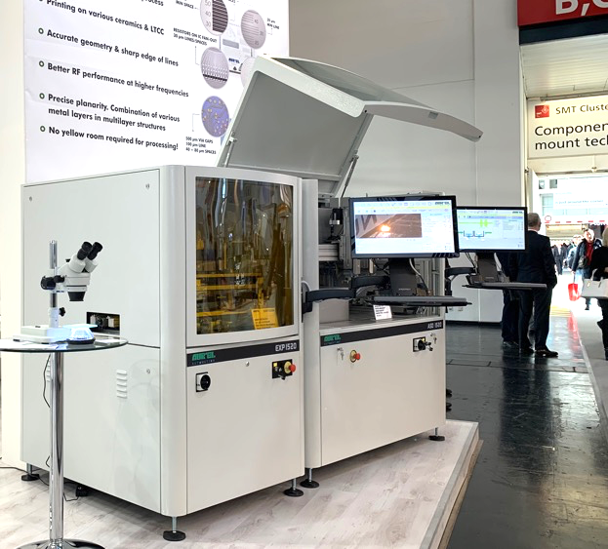

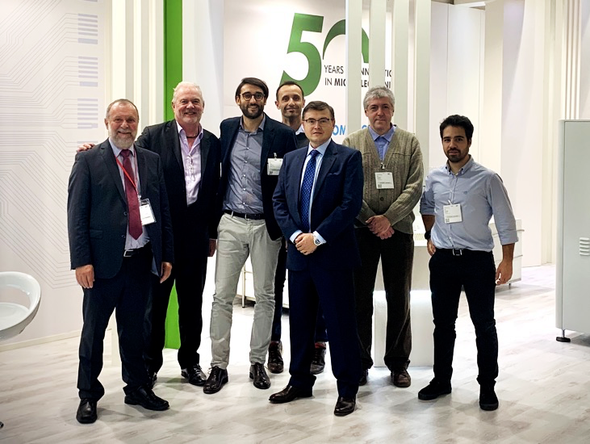
Fully automatic Process Lines
Available for test runs and delivery
2019
World premiere of Aurel EXP-1520 UV exposure unit and Aurel ASD-1520 spray developer,
core items of an automated line, at Productronica 2019, Munich
Mozaik Technology Ventures Limited Suites 34-35, The Hop Exchange, 24 Southwark St., SE1 1TY London UK | tel. +44 (0) 20 7357 7376 | fax +44 (0) 20 7357 9449 |

Slide 24
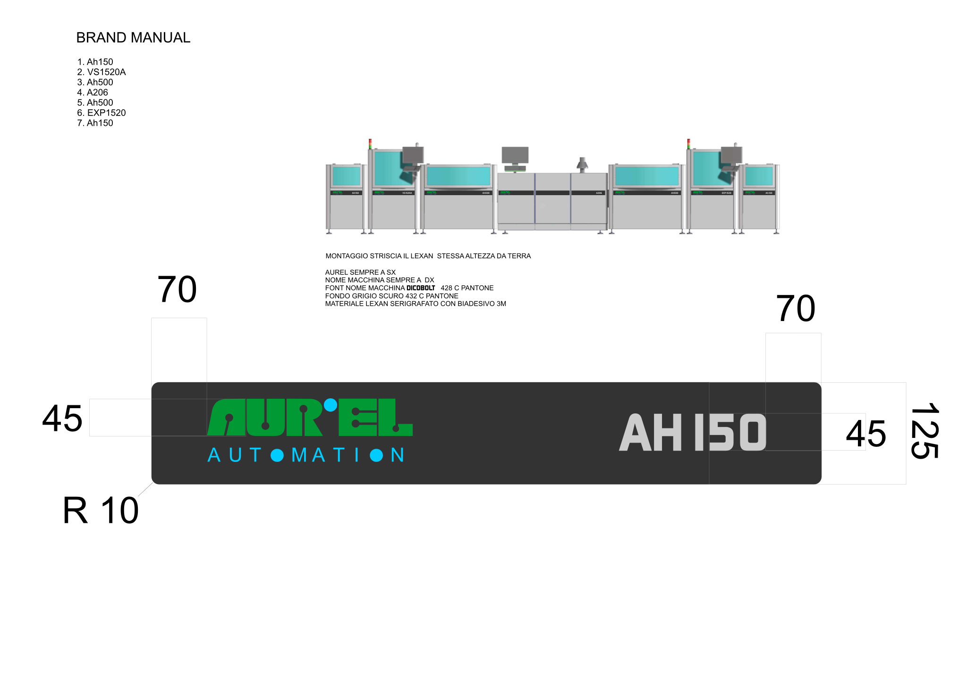

Fully automatic Process Lines
Available for test runs and delivery
Line I Exposure
Loader from cassette or stack
Screen Printer
Collocator to Dryer
IR Dryer
Collocator / AOI
UV-Exposure
Unloader
Line 2 Developer
Loader from cassette or stack
Water spray Developing
AOI and sorting
Unloader to Firing Oven
Mozaik Technology Ventures Limited Suites 34-35, The Hop Exchange, 24 Southwark St., SE1 1TY London UK | tel. +44 (0) 20 7357 7376 | fax +44 (0) 20 7357 9449 |

Slide 25
Fully automatic Process Lines
Delivery starts in 2020
https://www.youtube.com/watch?v=nB9mmK9oSok
Mozaik Technology Ventures Limited Suites 34-35, The Hop Exchange, 24 Southwark St., SE1 1TY London UK | tel. +44 (0) 20 7357 7376 | fax +44 (0) 20 7357 9449 |

Slide 26
III. Fine Line Process Advantages
Mozaik Technology Ventures Ltd., Suites 34-35, The Hop Exchange, 24 Southwark St., SE1 1TY London UK | tel. +44 (0) 20 7357 7376 | fax +44 (0) 20 7357 9449 |

Slide 27
General Advantages of Thick Film for Microwave Applications
Advantages of ‘conventional’ thick film over thin film
Low cost, fast process
No chemical waste
No hazardous gases
Less cleanroom constraints (Class 10.000 – ISO 7)
Through hole metallisation is easy
A broader range of resistors is possible
Multilayers are possible
Mozaik Technology Ventures Limited Suites 34-35, The Hop Exchange, 24 Southwark St., SE1 1TY London UK | tel. +44 (0) 20 7357 7376 | fax +44 (0) 20 7357 9449 |

Slide 28
Advantages of Photoimageable Thick Film for Microwave Applications
Additional advantages of photoimageable process
Precise shape and planarity multilayer structures
Better RF performance at higher frequencies
Very fine lines with accurate geometry and sharp edges
Low resistivity (higher conductivity) of fine lines
Photoimageable dielectric and mixed metal conductor compositions are possible
Mozaik Technology Ventures Limited Suites 34-35, The Hop Exchange, 24 Southwark St., SE1 1TY London UK | tel. +44 (0) 20 7357 7376 | fax +44 (0) 20 7357 9449 |

Slide 29
Paste Profile
Photoimageable vs. Standard Thick Film
Due to the nature of a drying process, dried paste always has a higher “crust” profile along the edges, which causes RF noise and complicates multilayer layout build-up
Much better line/space resolution
(grey areas approx. 15um lines / 15 um spaces)
“Crust” edges of the dried print (blue line)
were washed away, and surface of remaining conductor remains flat
100…150 um
15 um
15 um
15 um
!!
!!
✔️
✘
✘
Conductor track section
Substrate
Standard Thick Film after Drying
(exaggerated for illustration purpose)
Photoimageable Paste
Mozaik Technology Ventures Limited Suites 34-35, The Hop Exchange, 24 Southwark St., SE1 1TY London UK | tel. +44 (0) 20 7357 7376 | fax +44 (0) 20 7357 9449 |

Slide 30
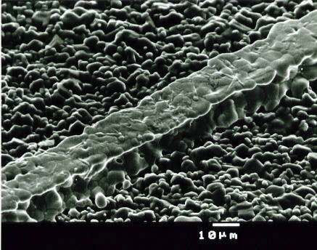
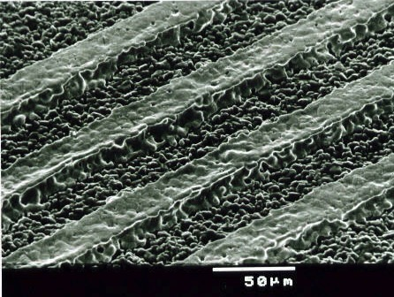
Paste Profile
Standard 96% “as-fired” alumina substrate
Conductor lines are continuous and have nearly perfect edges
(no “saw-tooth” due to screen mesh openings) which reduces RF cross-talk
Results on lapped / polished substrate are even better
Mozaik Technology Ventures Limited Suites 34-35, The Hop Exchange, 24 Southwark St., SE1 1TY London UK | tel. +44 (0) 20 7357 7376 | fax +44 (0) 20 7357 9449 |

Slide 31
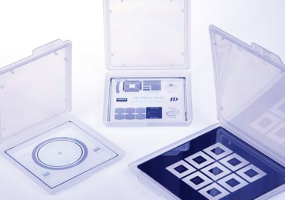
Running Costs
Photoimageable vs. Thin Film
7’’ glass photomask (from JD Photomasks or other specialist company) or Plastic Film masks (easy to produce at any PCB facility with a plotter)
Pastes (cost is not too different from regular thick film pastes)
Developer solution <0.3% MEA in pure water (very cheap and not hazardous)
NO OTHER MATERIALS OR CHEMICALS ARE USED
Mozaik Technology Ventures Limited Suites 34-35, The Hop Exchange, 24 Southwark St., SE1 1TY London UK | tel. +44 (0) 20 7357 7376 | fax +44 (0) 20 7357 9449 |

Slide 32
Running Costs
Photoimageable vs. Thin Film
Low power consumption (compared to thin film process)
Image formed and checked before firing (higher yield)
Defect images can be removed, substrate reused
Metal waste collectable as solid sediment (not sputtered or dissolved)
Combination of various metal layers possible
Printing on fired ceramics and LTCC (green tape) possible with same equipment kit
Mozaik Technology Ventures Limited Suites 34-35, The Hop Exchange, 24 Southwark St., SE1 1TY London UK | tel. +44 (0) 20 7357 7376 | fax +44 (0) 20 7357 9449 |

Slide 33

Running Costs
Photoimageable vs. Thin Film
Photoimageable pastes can be used only on fine line areas, and perfectly combine with conventional thick film pastes
They can be processed in normal cleanroom, no yellow room required
All waste is a solid metal powder sediment that can be reclaimed at pure metal value (not as a solution)
Industry needs RF and interconnect solutions more cost-efficient than thin film
Mozaik Technology Ventures Limited Suites 34-35, The Hop Exchange, 24 Southwark St., SE1 1TY London UK | tel. +44 (0) 20 7357 7376 | fax +44 (0) 20 7357 9449 |

